Slide 1
15-453
FORMAL LANGUAGES, AUTOMATA AND COMPUTABILITY
Notes:
-- Your homework is due Thursday.
-- I put up some more project ideas on the “What’s new” page for the website. If you’re looking for something to do, check these out, check out some of their references, etc.

Slide 2
CONTEXT-FREE GRAMMARS
AND PUSH-DOWN AUTOMATA

Slide 3
NONE OF THESE ARE REGULAR
Σ = {0, 1}, L = { 0^{n}1^{n} | n ≥ 0 }
Σ = {a, b, c, …, z}, L = { w | w = w^{R} }
Σ = { (, ) }, L = { balanced strings of parens }
(), ()(), (()()) are in L, (, ()), ())(() are not in L
Notes:
Consider the following languages.
While none of them are regular, today we’ll define a model of computation that CAN recognize them.

Slide 4
PUSHDOWN AUTOMATA (PDA)
FINITE STATE CONTROL
INPUT
STACK
(Last in,
first out)
Notes:
A Pushdown Automaton is an NFA armed with a stack.
On a single step, it reads the current symbol from the input
and it pops the symbol on the top of the stack.
Based on its state, and these two symbols, it moves to a new state, moves its input head to the right,
and pushes a new symbol onto the stack.
(It’s possible for it to pop nothing, or push nothing, it depends on the rules in its transition function.)

Slide 5
input
pop
push
ε,ε → $
0011
11
0,ε → 0
0011
011
1,0 → ε
ε,$ → ε
1
1,0 → ε
STACK
$
0
0
$
$
Non-deterministic
Notes:
The stack always begins empty.
So it accepts the string 0011.

Slide 6
input
pop
push
ε,ε → $
001
1
0,ε → 0
001
01
1,0 → ε
ε,$ → ε
1,0 → ε
STACK
$
0
0
$
$
PDA that recognizes L = { 0^{n}1^{n} | n ≥ 0 }
Notes:
Informally, the PDA works by pushing 0’s onto the stack each time it sees a 0, then once it begins reading 1’s it pops a 0 for every 1 it sees.
The machine accepts if and only if the stack has $ at the top, precisely when it runs out of reading 1’s.

Slide 7
Definition: A (non-deterministic) PDA is a tuple P = (Q, Σ, Γ, δ, q₀, F), where:
Q is a finite set of states
Σ is the input alphabet
Γ is the stack alphabet
δ : Q × Σ_{ε} × Γ_{ε} → 2 ^{Q × Γ}ε
q₀ ∈ Q is the start state
F ⊆ Q is the set of accept states
2^{Q} is the set of subsets of Q and Σ_{ε} = Σ ∪ {ε}
Notes:
Transition function’s a little more complicated now:
Reads a state, Input symbol (or possibly eps), Symbol popped from stack (or possibly eps),
From there a variety of moves can be made,
each of which can change the state and push a new symbol onto the stack.

Slide 8
Let w∈ Σ* and suppose w can be written as
w₁... w_{n} where w_{i} ∈ Σ_{ε} (recall Σ_{ε} = Σ ∪ {ε})
Then P accepts w if there are
r₀, r₁, ..., r_{n} ∈ Q and
s₀, s₁, ..., s_{n} ∈ Γ* (sequence of stacks) such that
r₀ = q₀ and s₀ = ε (P starts in q₀ with empty stack)
For i = 0, ..., n-1:
(r_{i+1} , b)∈ δ(r_{i}, w_{i+1}, a), where s_{i} =at and s_{i+1} = bt for some a, b ∈ Γ_{ε} and t ∈ Γ*
(P moves correctly according to state, stack and symbol read)
3. r_{n} ∈ F (P is in an accept state at the end of its input)
Notes:
The definition of acceptance is more complicated too!
2. Suppose we’re in state ri, reading wi+1, and we popped stack symbol a.
And suppose that one possible transition is to move to ri+1 and push symbol b.

Slide 9
ε,ε → $
q₀
q₁
0,ε → 0
1,0 → ε
ε,$ → ε
q₃
q₂
1,0 → ε
Q = {q₀, q₁, q₂, q₃}
Σ =
{0,1}
Γ =
{$,0,1}
δ : Q × Σ_{ε} × Γ_{ε} → 2 ^{Q × Γ}ε
δ(q₁,1,0) =
{ (q₂,ε) }
δ(q₂,1,1) =
∅
Notes:
Rather than give the whole transition function, let’s look at two examples.

Slide 10
EVEN-LENGTH PALINDROMES
Σ = {a, b, c, …, z}
ε,ε → $
σ,ε → σ
q₀
q₁
ε,ε → ε
ε,$ → ε
q₃
q₂
σ,σ → ε
Notes:
What does this PDA do? What language does it recognize?
Starts by pushing $, then it pushes letters on the stack as it reads them.
At some point it nondeterministically moves to q2, and starts popping letters.
Finally it accepts if it sees $ precisely when its input has run out.
“noon” , “otto”, “zeus sees suez”

Slide 11
Build a PDA to recognize
L = { a^{i}b^{j}c^{k} | i, j, k ≥ 0 and (i = j or i = k) }
b,a → ε
c,ε → ε
q₀
ε,$ → ε
q₂
q₃
ε,ε → ε
choose i=j
ε,ε → $
choose i=k
q₁
q₄
q₅
q₆
ε,ε → ε
ε,ε → ε
ε,$ → ε
a,ε → a
b,ε → ε
c,a → ε
Notes:
We start by loading $ on the stack. Then we load a’s on to the stack as we read them.
At some point, we “guess” that we’re through reading a’s, and
we choose to either satisfy i=j or i=k.
If we choose i=j, then for every b we read, we pop an a. And then we accept no matter what the c’s are, if we popped $ at the end.
If we choose i=k, then we read some number of b’s but we don’t touch the stack. We “guess” when we’ll start reading c’s, then we pop an ‘a’ for each c we read.

Slide 12
CONTEXT-FREE GRAMMARS
production
rules
start variable
A → 0A1
A → B
B → #
variables
terminals
A
0A1
(yields)
⇒ 00A11
⇒ 00B11
⇒ 00#11
Derivation
A ⇒* 00#11
(derives)
We say: 00#11 is generated by the Grammar
Non-deterministic
Notes:
Now we’ll switch gears and start talking about something that on the surface looks quite different.
These grammars “generate” strings made up of terminals.
Starting from the variable A, we can “generate” a string as follows.
We apply a rule from above, replacing the variable with the right hand side of a rule.

Slide 13
CONTEXT-FREE GRAMMARS
A → 0A1
A → B
B → #
A → 0A1 | B
B → #

Slide 14
CONTEXT-FREE GRAMMARS
A context-free grammar (CFG) is a tuple
G = (V, Σ, R, S), where:
V is a finite set of variables
Σ is a finite set of terminals (disjoint from V)
R is set of production rules of the form A → W, where A ∈ V and W ∈ (V∪Σ)*
S ∈ V is the start variable
  L(G) = {w ∈ Σ* | S ⇒* w} Strings Generated by G
Notes:
L(G) = set of strings such that from the start symbol we can derive the string.
We say a language L is context-free if there is a grammar that generates precisely the strings in it.

Slide 15
CONTEXT-FREE LANGUAGES
A context-free grammar (CFG) is a tuple
G = (V, Σ, R, S), where:
V is a finite set of variables
Σ is a finite set of terminals (disjoint from V)
R is set of production rules of the form A → W, where A ∈ V and W ∈ (V∪Σ)*
S ∈ V is the start variable
G = { {S}, {0,1}, R, S }
R = { S → 0S1, S → ε }
  L(G) =

Slide 16
CONTEXT-FREE LANGUAGES
A context-free grammar (CFG) is a tuple
G = (V, Σ, R, S), where:
V is a finite set of variables
Σ is a finite set of terminals (disjoint from V)
R is set of production rules of the form A → W, where A ∈ V and W ∈ (V∪Σ)*
S ∈ V is the start variable
G = { {S}, {0,1}, R, S }
R = { S → 0S1, S → ε }
  L(G) = { 0^{n}1^{n} | n ≥ 0 } Strings Generated by G

Slide 17
WRITE A CFG FOR EVEN-LENGTH PALINDROMES
S → σSσ for all σ ∈ Σ
S → ε

Slide 18
WRITE A CFG FOR THE EMPTY SET
G = { {S}, Σ, ∅, S }
Notes:
It’s just a grammar with no production rules!

Slide 19
PARSE TREES
A
A
A
B
0
0
#
1
1
A
⇒ 0A1
⇒ 00A11
⇒ 00B11
⇒ 00#11
Notes:
One very convenient way of representing a particular derivation by a CFG is with a parse tree.

Slide 20
<EXPR> → <EXPR> + <EXPR>
<EXPR> → <EXPR> x <EXPR>
<EXPR> → ( <EXPR> )
<EXPR> → a
Build a parse tree for a + a x a
<EXPR>
<EXPR>
<EXPR>
<EXPR>
<EXPR>
<EXPR>
<EXPR>
<EXPR>
<EXPR>
<EXPR>
a
+
a
x
a
a
+
a
x
a
Notes:
We have to be careful though:
it can be that there are multiple parse trees.

Slide 21
Definition: a string is derived ambiguously in a context-free grammar if it has more than one parse tree
Definition: a grammar is ambiguous if it generates some string ambiguously
See G₄ for unambiguous standard arithmetic precedence
Notes:
There’s an example in Sipser’s book, in Chapter 2, of an unambiguous way to represent arithmetic expressions.
on p.95 in the first edition,
p.103 in 2nd edition.

Slide 22
NOT REGULAR
Σ = {0, 1}, L = { 0^{n}1^{n} | n ≥ 0 }
But L is CONTEXT FREE
A → 0A1
A → ε
WHAT ABOUT?
Σ = {0, 1}, L₁ = { 0^{n}1^{n} 0^{m}| m,n ≥ 0 }
Σ = {0, 1}, L₂ = { 0^{n}1^{m} 0^{n}| m,n ≥ 0 }
Σ = {0, 1}, L₃ = { 0^{m}1^{n} 0^{n}| m=n ≥ 0 }
Notes:
How can we tell what is context-free and what isn’t?

Slide 23
THE PUMPING LEMMA FOR CFGs
Let L be a context-free language
Then there is a P such that
if w ∈ L and |w| ≥ P
then can write w = uvxyz, where:
1. |vy| > 0
2. |vxy| ≤ P
3. For every i ≥ 0, uv^{i}xy^{i}z ∈ L
Notes:
The pumping lemma for CFGs lets us “pump” at two places in the string.
So how can we use this to prove a contradiction?
Just like the pumping lemma for FAs:
Let P be given. We choose a w of length P.
We consider all the possible ways it might be partitioned up into uvxyz.
For each such way, we argue that some “pumping” of w can’t be in our language L.

Slide 24
Idea of Proof: If w is long enough, then
any parse tree for w must have a path that contains a variable more than once
T
T
R
R
R
R
R
R
u
v
x
y
z
u
v
y
z
v
x
y

Slide 25
Formal Proof:
Let b be the maximum number of symbols on the right-hand side of any rule
If the height of a parse tree is h, the length of the string generated by that tree is at most:
b^{h}
Let |V| be the number of variables in G
Define P = b^{|V|+2}
Let w be a string of length at least P
Let T be a parse tree for w with a minimum number of nodes.
T must have height at least |V|+2

Slide 26
The longest path in T must have ≥ |V|+1 variables
Select R to be the variable that repeats among the lowest |V|+1 variables (in the path)
T
T
1. |vy| > 0
2. |vxy| ≤ P
R
R
R
R
R
Let T be a parse tree for w with a minimum number of nodes. T must have height at least |V|+2
R
u
v
x
y
z
u
v
y
z
v
x
y
Notes:
Why does such an R exist? (PIGEONHOLE PRINCIPLE)
Why is |vy| > 0?
We chose a minimum size parse tree: if they were empty we could get a smaller parse tree for w.
Why is |vxy| <= P?
Note the top R is at most |V|+1 variables from the bottom.
So the subtree rooted at R has at most b^{|V|+1} <= P nodes in it.
That is, the length of v,x,y is at most P.

Slide 27
WHAT ABOUT?
Σ = {0, 1}, L₁ = { 0^{n}1^{n} 0^{m}| m, n ≥ 0 }
Σ = {0, 1}, L₂ = { 0^{n}1^{m} 0^{n}| m, n ≥ 0 }
Σ = {0, 1}, L₃ = { 0^{m}1^{n} 0^{n}| m=n ≥ 0 }
Notes:
L1 and L2 are context free, but L3 isn’t…
For L1:
S -> AB
A -> 0A1 | eps
B -> 0B | eps
For L2:
S -> 0S0 | A
A -> 1A | eps
For L3:
Choose w = 0^P 1^P 0^P.
Pumping Lemma: w = uvxyz
|vy| > 0, |vxy| <= P, and uxz in L.
Now vxy = 0^a 1^b, or vxy = 1^a 0^b,
where a, b >= 0.
In either case, we get that:
uxz = 0^I 1^J 0^K, where I, J, K are not all equal.
So uxz isn’t in L3, but w is. Contradiction.

Slide 28
THE PUMPING LEMMA
Let L be a context-free language
Then there exists P such that
if w ∈ L and |w| ≥ P
then w = uvxyz, where:
1. |vy| > 0
2. |vxy| ≤ P
3. uv^{i}xy^{i}z ∈ L for any i ≥ 0

Slide 29
Idea: If w is long enough, then any parse tree for w must have a path that contains a variable more than once
T
T
R
R
R
R
R
R
u
v
x
y
z
u
v
y
z
v
x
y

Slide 30
Formal Proof:
Let b be the maximum number of symbols on the right-hand side of a rule
If the height of a parse tree is h, the length of the string generated is at most:
b^{h}
Let |V| be the number of variables in G
Define P = b^{|v|+1}
Let w be a string of length at least P (= b^{|v|+1} )
Let T be the parse tree for w with the smallest number of nodes.
T must have height at least |V|+1

Slide 31
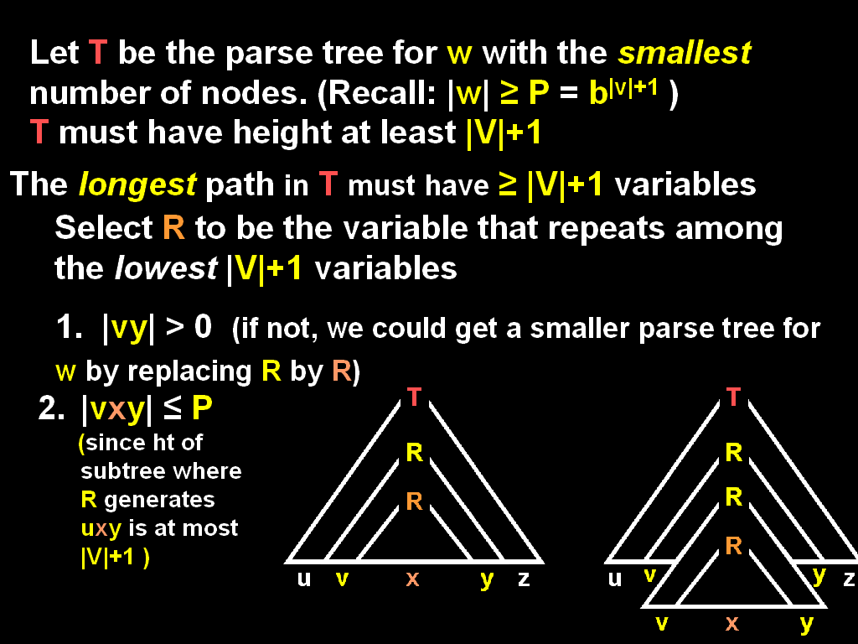

Slide 33
EQUIVALENCE OF CFGs and PDAs
A Language L is generated by a CFG
⇔
L is recognized by a PDA
Notes:
So CFGs and PDAs have a relationship like that between REGEXPs and NFAs:
One of them is a “descriptive” way of saying what strings are in the language,
and the other is an algorithmic, machine-based way of saying it.
Both ways are equally valid, and one can be more useful than the other depending on context.

Slide 34
Read the rest of Chapter 2 for next time

